Slide 1
Pyscript running python in the browser

Slide 2

What's Pyscript
PyScript is an open source platform to run python in the browser
Web assembly based
Make fully interactive app as static webpage
Some html/javascript required
Some links:
pyscript.net
pyscript.net/examples/
pyodide.org

Slide 3
Pyscript project structure
index.html : the webpage
main.py : the script
pyscript.toml/.json: the required packages

Slide 4
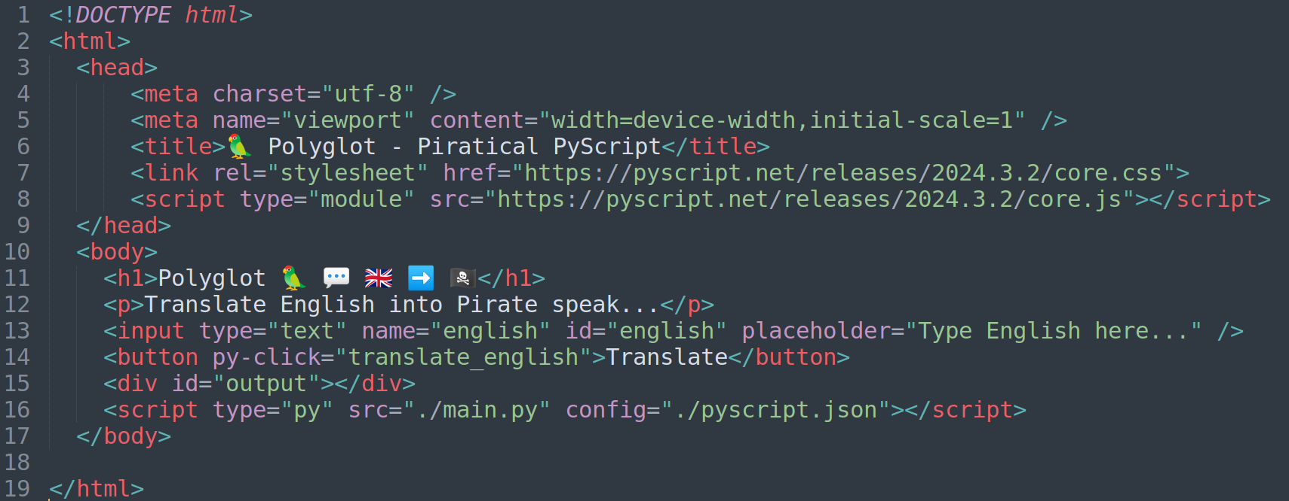
Pyscript project structure
index.html : the webpage

Slide 5
Pyscript project structure
index.html : the webpage

Slide 6
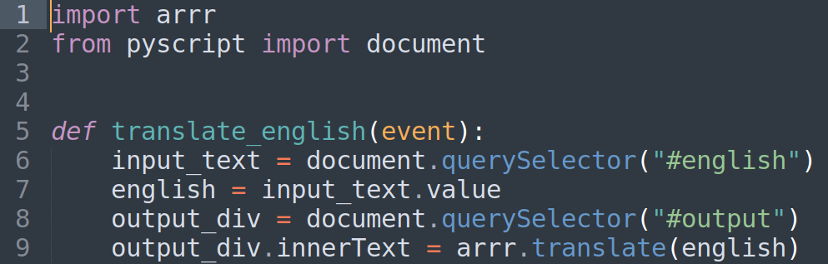
Pyscript project structure
main.py : the script

Slide 7
Pyscript project structure
main.py : the script

Slide 8
Pyscript project structure
main.py : the script

Slide 9
Pyscript project structure
main.py : the script

Slide 10
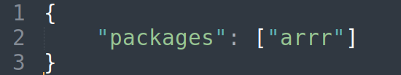
Pyscript project structure
pyscript.json : the required packages
pyscript.toml : alternative syntax

Slide 11
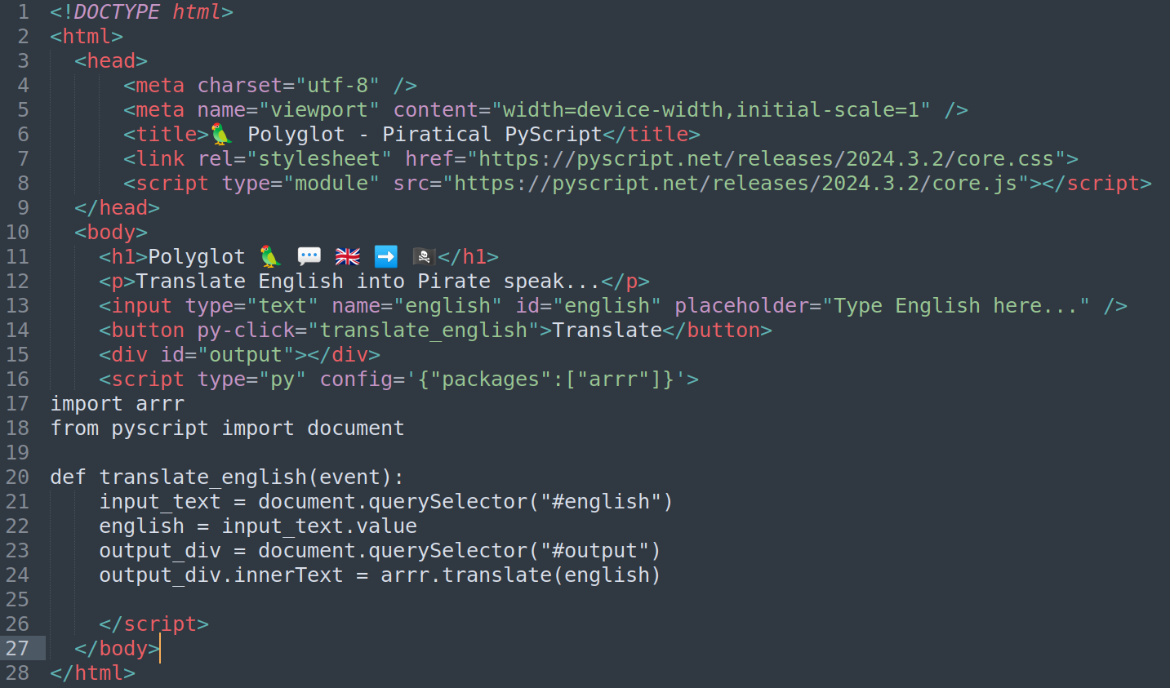
Alternative: inline everything

Slide 12
Going farther:
https://pyscript.net/examples/
https://docs.pyscript.net/2024.10.2/
https://github.com/anaconda/pyscript-tutorial
https://www.javatpoint.com/pyscript
https://realpython.com/pyscript-python-in-browser/

